Slide 1
Design Patterns

Slide 2
What is a Design Pattern?
A (Problem, Solution) pair.
A technique to repeat designer success.

Slide 3




How Patterns are used?
Designer
Design Problem.
Solution.
Implementation details.
Programmer
Reduce gap
Design
Implementation

Slide 4
Design patterns you have already seen
Encapsulation (Data Hiding)
Subclassing (Inheritance)
Iteration
Exceptions

Slide 5
Derived Conclusion
Patterns are Programming language features.
Programming languages are moving towards Design.
Many patterns are being implemented in programming languages.

Slide 6
Pattern Categories
Creational Patterns concern the process of object creation.
Structural Patterns concern with integration and composition of classes and objects.
Behavioral Patterns concern with class or object communication.

Slide 7
What is the addressing Quality Attribute?
Modifiability, Exchangeability, Reusability, Extensibility, Maintainability.
What properties these patterns provide?
More general code for better Reusability.
Redundant code elimination for better Maintainability.

Slide 8
Creational Patterns

Slide 9
Deals with
the object creation mechanisms
In a manner
Suitable to a given situation

Slide 10
1. Singleton
2. Factory
3. Abstract factory
4. Builder
5. Prototype

Slide 11
1. Singleton Pattern
Used where
only one object (instance)
- of a particular class is instantiated or required.
And this one instance
- will coordinate all actions across the applications
Ex. Prime minister or president of a country,
Principal of a college, etc.

Slide 12
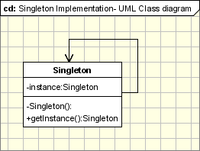

Slide 13
The Singleton Pattern - defines a getInstance operation , which exposes the unique instance, which is accessed by the clients.

Slide 14
2. Factory Pattern

Slide 15
This is the most used design pattern in modern programming languages like Java and C#.
creates objects
- without exposing the instantiation logic to the client.
refers to the newly created object
- through a common interface

Slide 16
The implementation is really simple
The client needs a product,
- but instead of creating it directly using the new operator,
- it asks the factory object for a new product,
- by providing the related details.
The factory instantiates
- a new concrete product and
- then returns to the client
- the newly created product
The client uses the products as abstract products
- without being aware about their concrete implementation.

Slide 17
3. Factory Method

Slide 18
The Factory method works just the same way:
it defines an interface for creating an object.
Ex. the hotel (a Room factory).
- Pay for a room, get a key and use the room.
While staying at the hotel,
you might need to make a phone call,
so you call the front desk and
the person there will connect you with the number you need,
becoming a phone-call factory,
because he controls the access to calls, too.

Slide 19
it is related to the idea on which libraries work:
a library uses abstract classes
- for defining and maintaining relations between objects.
- The library knows
- when an object needs to be created,
- but not what kind of object it should create,
- this being specific to the application using the library.

Slide 20
Intent
Defines an interface for creating objects,
but let subclasses to decide which class to instantiate
Refers to the newly created object through a common interface

Slide 21
The participants classes in this pattern are:
Product defines the interface for objects the factory method creates.
ConcreteProduct implements the Product interface.
Creator(also refered as Factory because it creates the Product objects)
declares the method FactoryMethod, which returns a Product object.
May call the generating method for creating Product objects
ConcreteCreator overrides the generating method for creating ConcreteProduct objects
All concrete products are subclasses of the Product class, so all of them have the same basic implementation, at some extent. The Creator class specifies all standard and generic behavior of the products and when a new product is needed, it sends the creation details that are supplied by the client to the ConcreteCreator.

Slide 22
4. Abstract Factory

Slide 23
Provides an interface
- for creating of object
- which are related or dependent.
It does not specify their concrete classes.
Abstract Factory
- offers the interface
- for creating a family of related objects,
- without explicitly specifying their classes

Slide 24
In other words,
the Abstract Factory is
- a super-factory which creates
- other factories (Factory of factories).

Slide 25
5. Builder Pattern
Used when there is a complex object structure.
Provides easy interface
- to the complex internal representation
- To the outside world.
Separates object construction from its representation
Ex. Menu card of - Multicourse dinner
Drink, starter, main course, desert.

Slide 26
6. Prototype Pattern
Allows –
- fully initialized object instance
- to be copied or cloned.
New objects are created by copying the prototype.
Or cloned.

Slide 27
rather than creation of new object, it uses cloning.
If the cost of creating a new object is large
- and creation is resource intensive,
- we clone the object.
It allows an object to create customized objects without knowing their class or any details of how to create them.
Up to this point it sounds a lot like the Factory Method pattern,
the difference being the fact that
for the Factory the palette of prototypical objects never contains more than one object.

Slide 28
Implementation
The pattern uses abstract classes, as we will see below and only three types of classes making its implementation rather easy.

Slide 29
Structural Patterns

Slide 30
1. Proxy
2. Decorator
3. Facade
4. Adaptor
5. Flyweight

Slide 31
1. Proxy Pattern
An object representing another object
acts as proxy of another object or acts as another object
A Place holder to another object, that controls the access to main object
Program → proxy → remote object
Ex. Proxy attendance
Ex. Credit /debit is a proxy for a bank account

Slide 32
2. Decorator
Some extra parameters added to the object.
Additional responsibilities are attached to an object dynamically, without changing the interface.
easy to add behavior at runtime.
Ex. 10 types of pizzas, add different toppings to each.
Ex. Decoration of a cake in different ways.
Ex. On E-commerce sites, Price of an item changing dynamically according to response.

Slide 33
3. Facade
A subsystem can have many interfaces.
Façade provide a single interface, as unified interface
to a set of interfaces.
Single class represents entire subsystems.
Ex. Event manager - Decoration of the place, food, drinks, invitation, music troop, etc.
Ex. Online order – check stock, reserve an item, make payment, update stock, generate invoice.
All are done by a single click (in UI layer)
In business layer, façade come into picture.

Slide 34
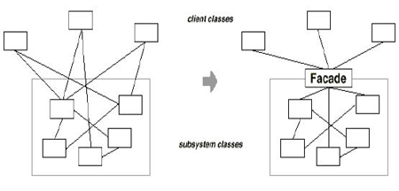

Slide 35
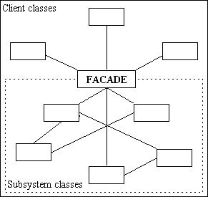

Slide 36
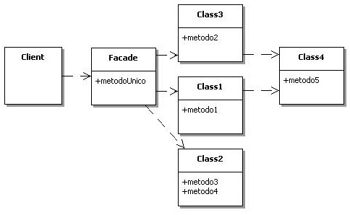

Slide 37
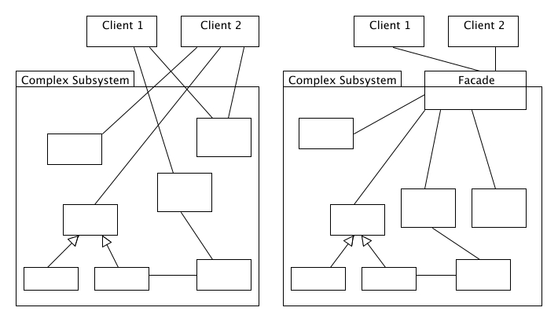

Slide 38
4. Adapter
Match interfaces of different classes
Interface of a class is converted into another interface as client expects
Two or more incompatible classes can communicate with each other
Ex. Power adapters.

Slide 39
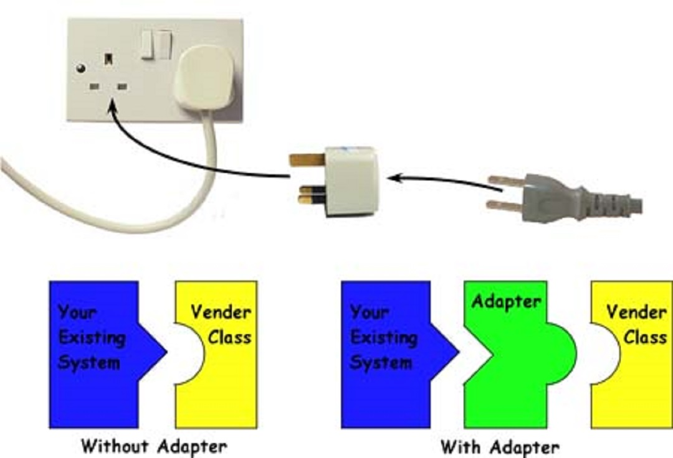

Slide 40
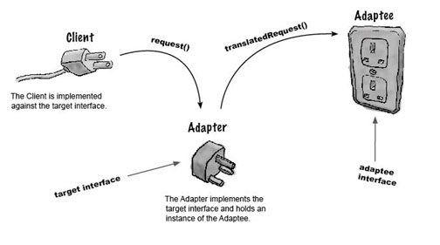

Slide 41
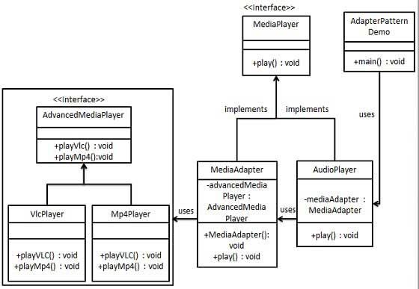

Slide 42
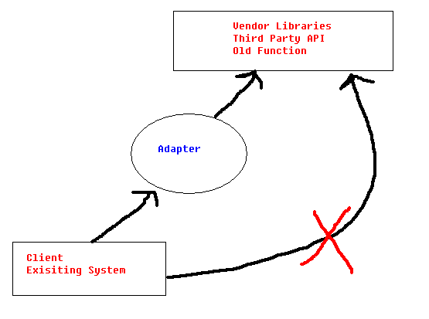

Slide 43
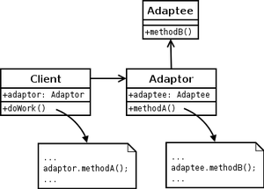

Slide 44
5. Flyweight
Large number of objects can be shared efficiently
Reuse the objects without creating the new ones each time.
The common part of various objects
- is stored and shared via a “Flyweight” object
A fine grained instance used for efficient sharing.
Ex. PSTN – limited number of lines used efficiently.

Slide 45
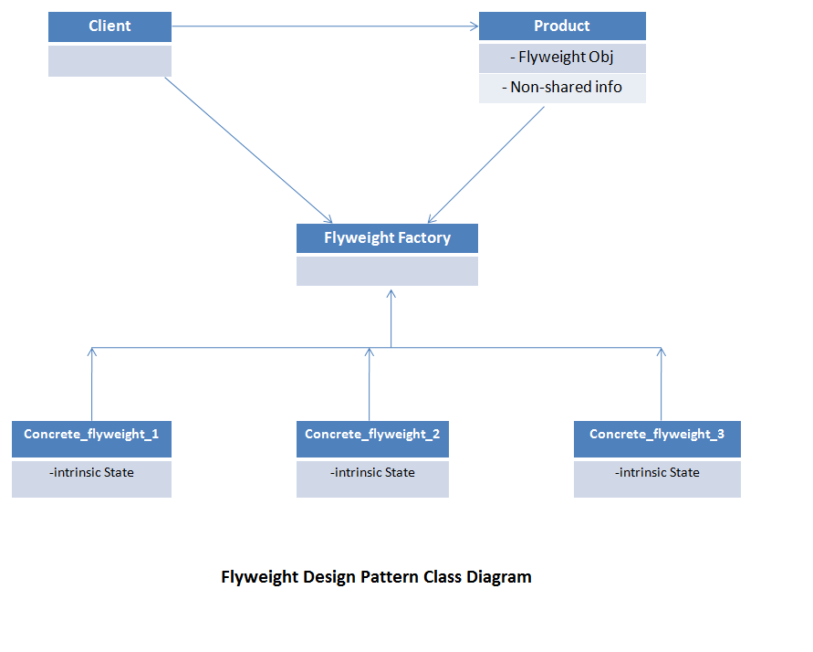

Slide 46
Flyweight Design Pattern Code Example:
Aeroplane industry scenario
in which each aeroplane common information like –
Type of aircraft, seating capacity, speed etc,
is stored at one place in flyweight objects.
which will be shared by all same kind of objects.
Unique information of each aeroplane like - Serial number and Manufacturing Date etc, can be saved directly in final object.
Class diagram for the solution of this problem is as shown in image.

Slide 47
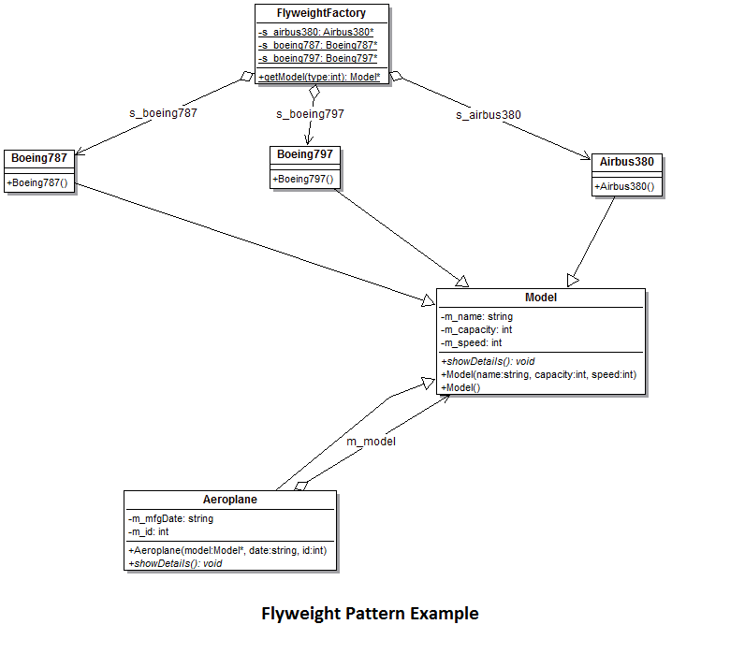

Slide 49
Behavioral Patterns

Slide 50
1. Chain of Responsibility
2. Iterator
3. State
4. Strategy
5. Observer
6. Visitor
7. Command
8. Memento
9. Mediator
10. Template method

Slide 51
1. Chain of Responsibility
A way of passing a request between a chain of objects , until that request is handled.
Ex. Loan approval process, admission process
Exception handling in java

Slide 52
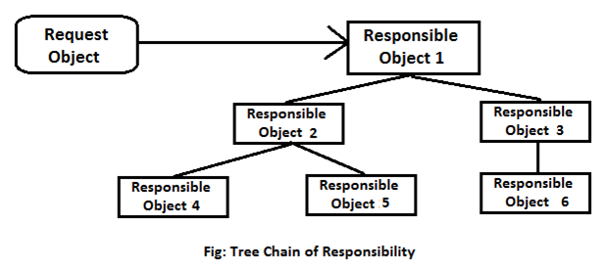

Slide 53
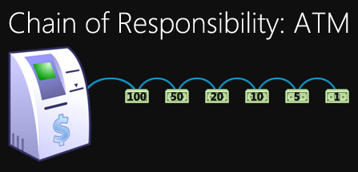

Slide 54
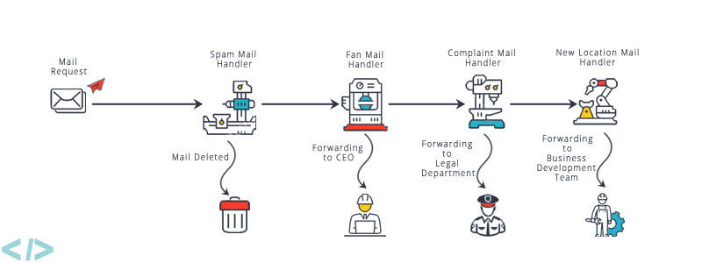

Slide 55
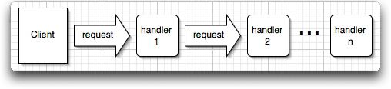

Slide 56
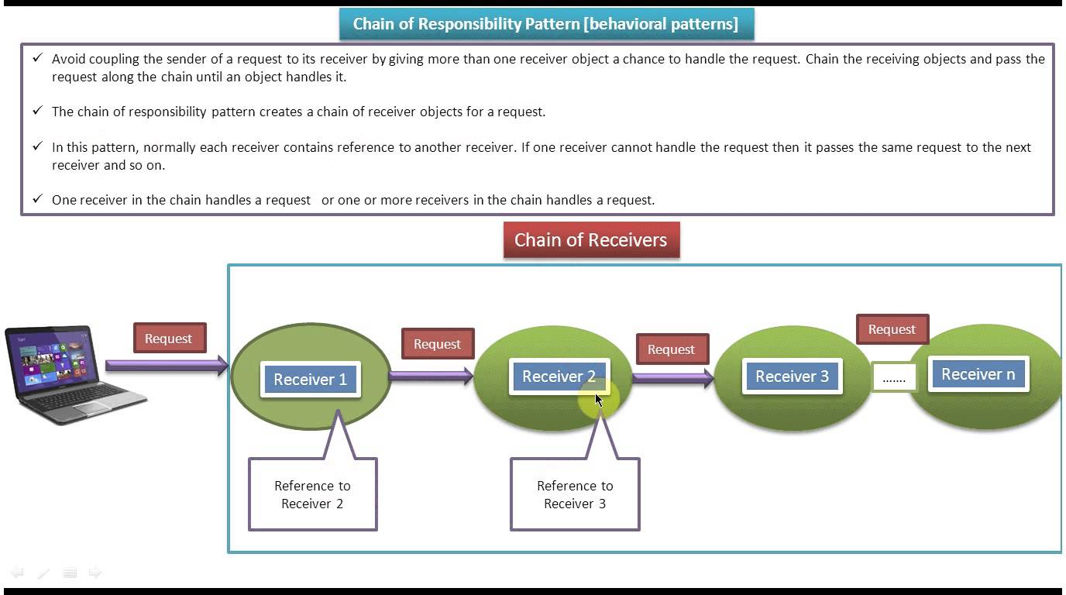

Slide 57
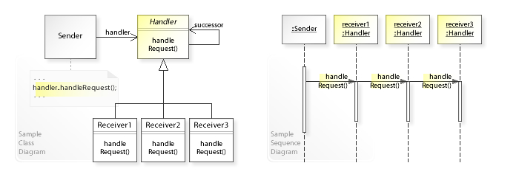

Slide 58
2. Iterator
Sequentially access the elements of a collection.
Without knowing internal details,
- the functionality (or the object)
- is repeatedly executing in loop fashion
- (based on some condition).
traverse a container and access the container's elements.
Ex. TV remote –
- Next button – for next channel
- Previous button – for previous channel.
i.e. without knowing the internal working of the remote, buttons can be used.

Slide 59
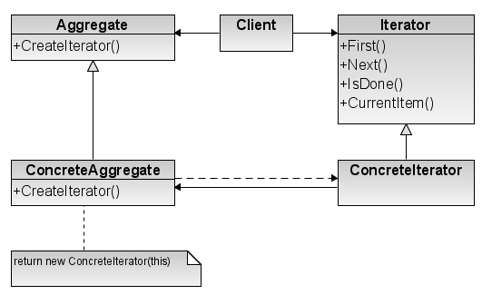

Slide 60
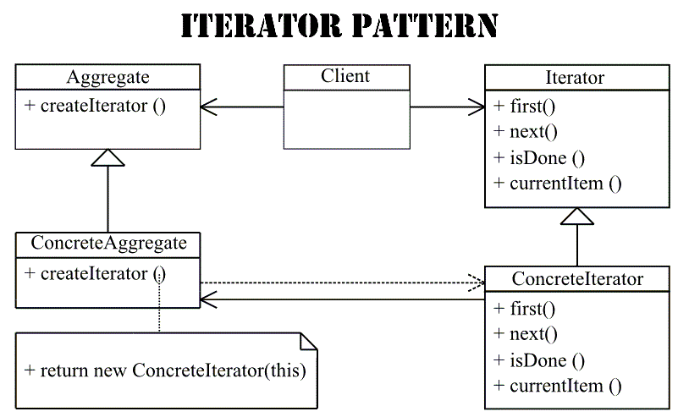

Slide 61
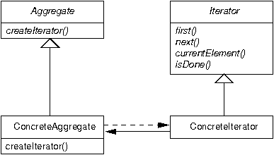

Slide 62
3. State
Alters the objects behavior,
when the internal state of the object changes.
allows full encapsulation of an unlimited number of states
on a context for easy maintenance and flexibility.
Ex. Fan wall control – level 0,1,2,3,4.

Slide 63
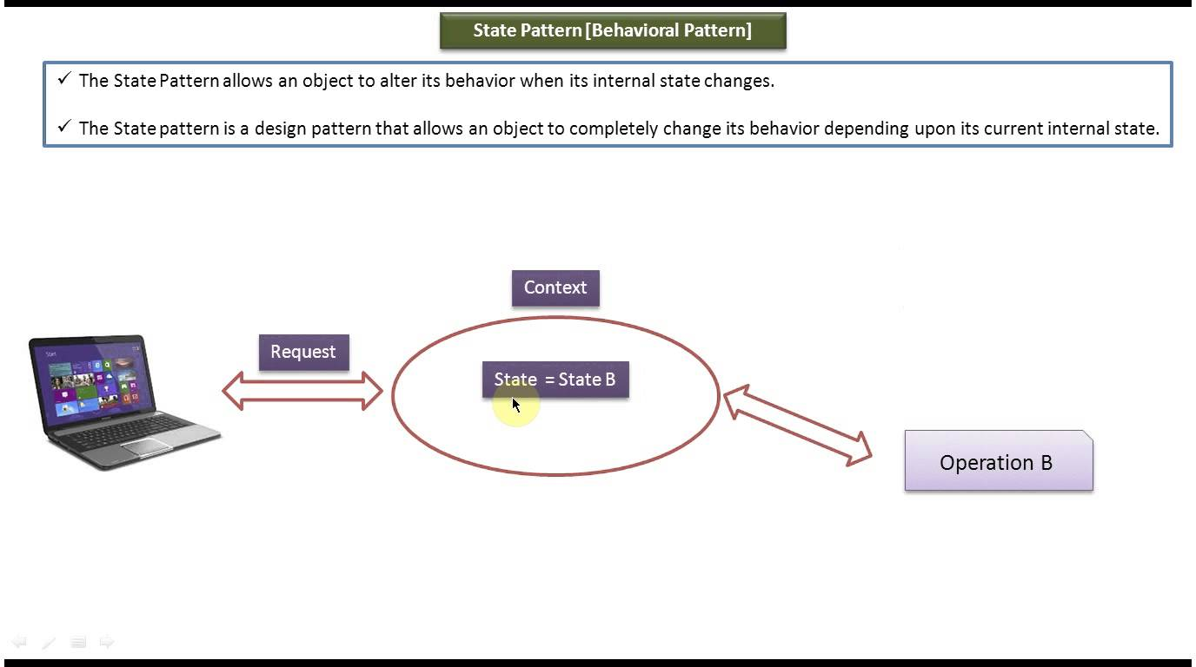

Slide 64
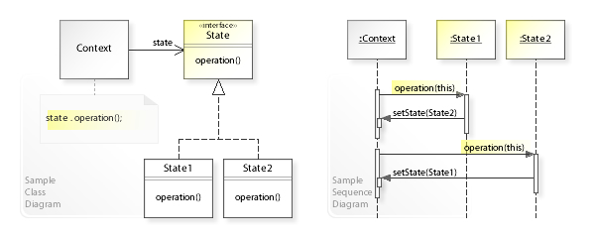

Slide 65
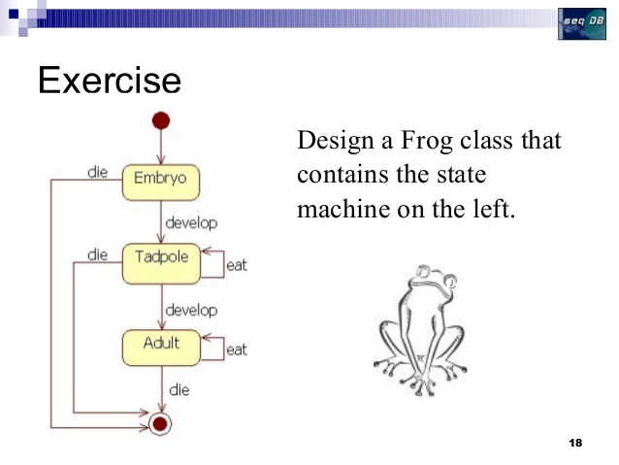

Slide 66
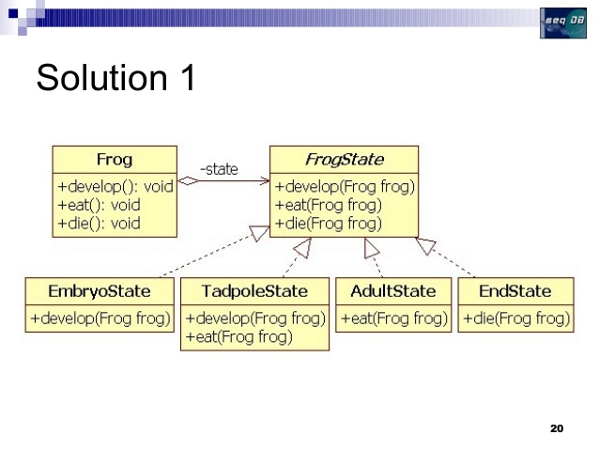

Slide 67
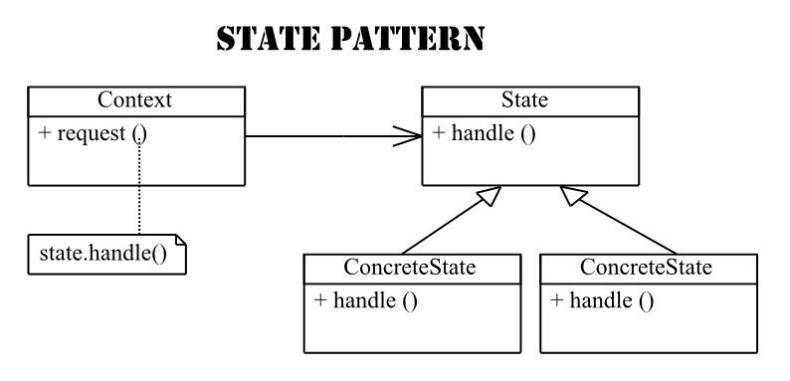

Slide 68
4. strategy
Encapsulates an algorithm inside a class.
enables selecting an algorithm at runtime.
defines a family of algorithms, encapsulates each algorithm, and
makes the algorithms interchangeable within that family.
Strategy lets the algorithm vary independently from clients that use it.
Ex. Java.util.comparator#compare()

Slide 69
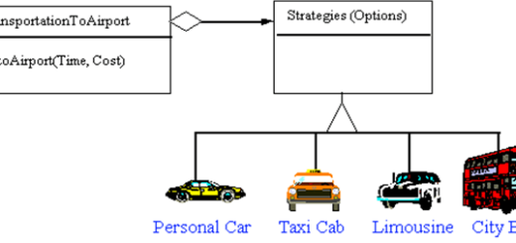

Slide 70
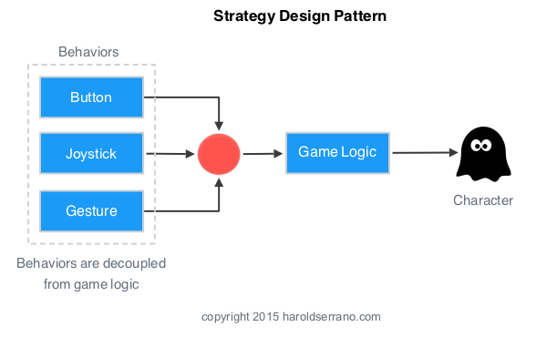

Slide 71
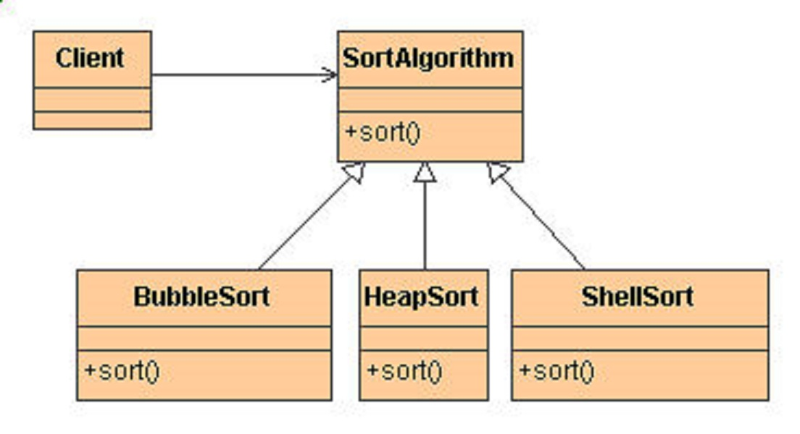

Slide 72
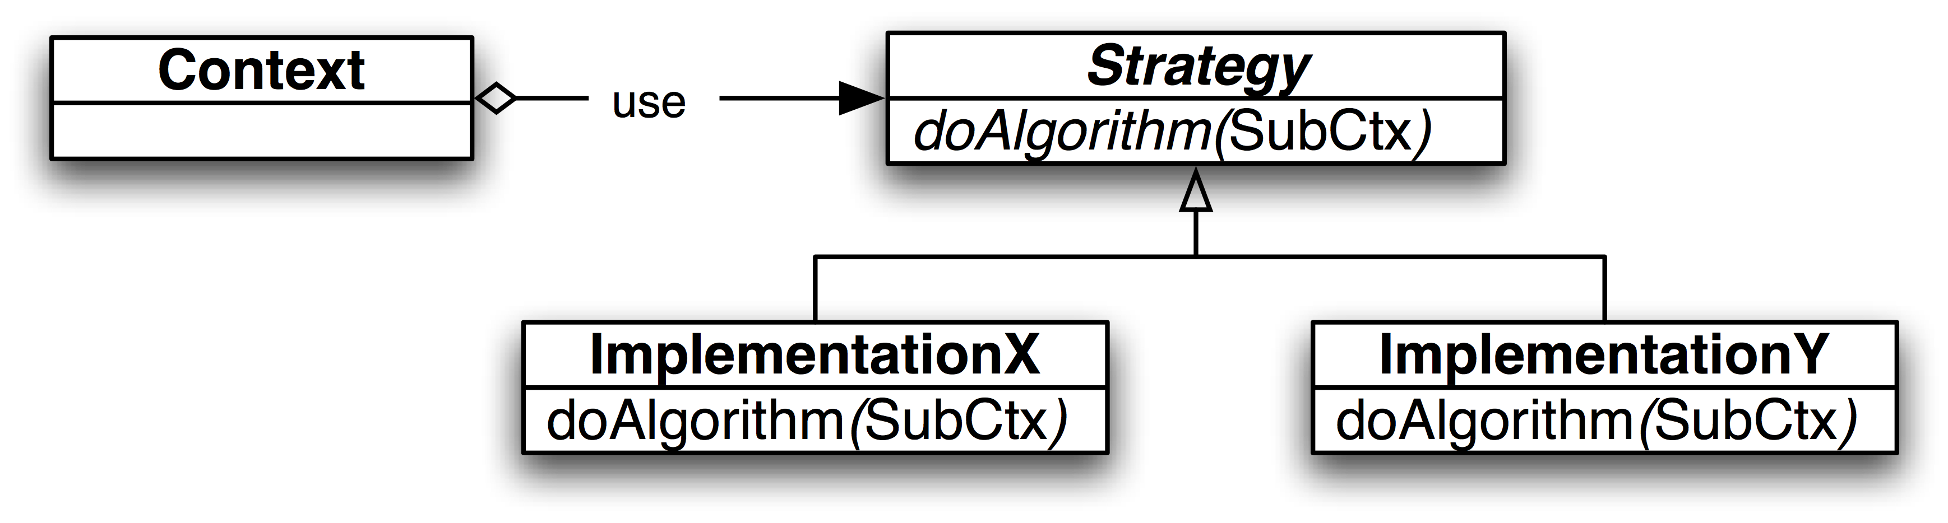

Slide 73
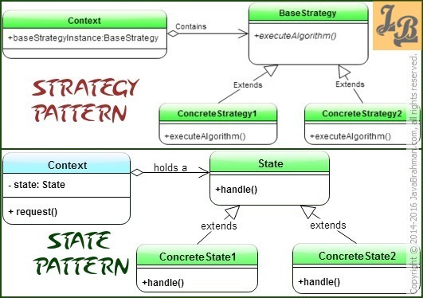

Slide 74
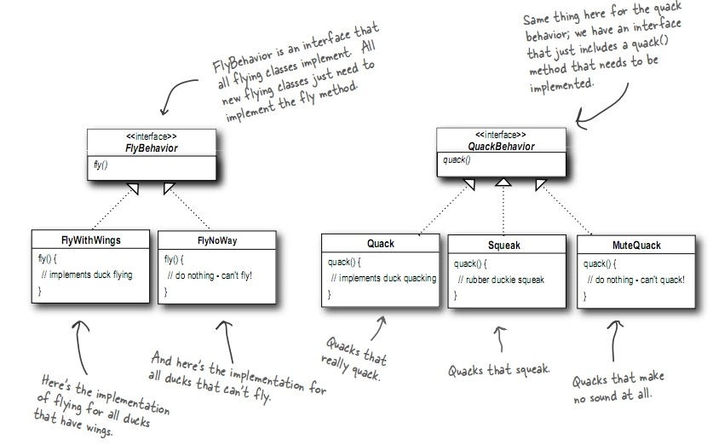

Slide 75
5. Observer
Allows one to many dependence between objects.
If the state of one object is changed,
all the dependent object are notified about the event.
A way of notifying the change, To a number of classes.
Ex. Online bidding –
- you can register and
- will be notified, when there is a new bid.
ex. Share market prices, notified to customers

Slide 76
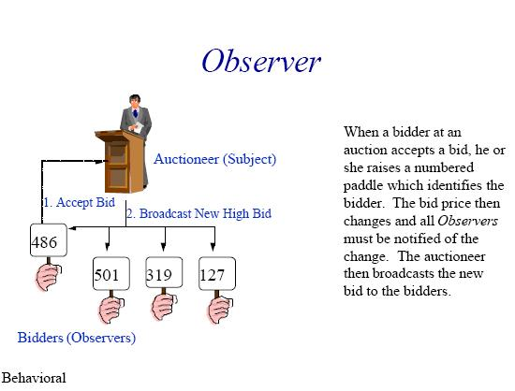

Slide 77
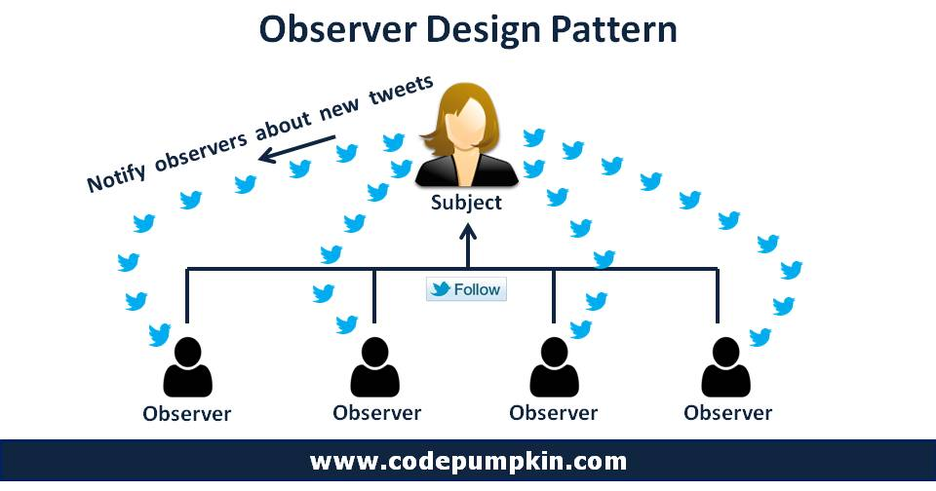

Slide 78
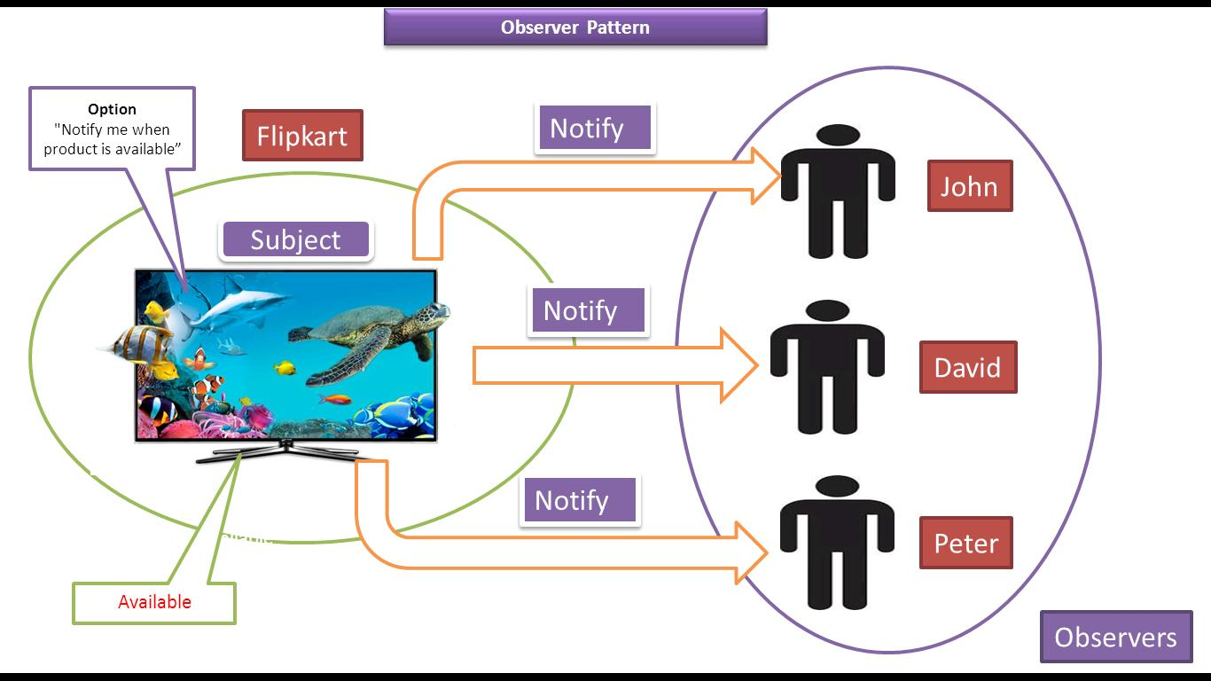

Slide 79
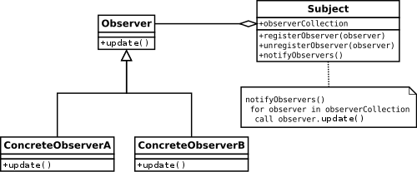

Slide 80
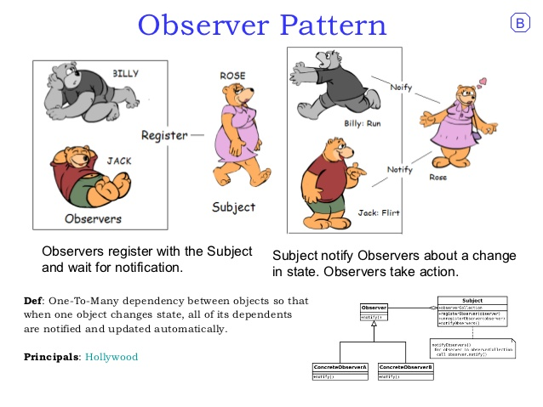

Slide 81
6. Visitor
Add new operations to the class, without making notifications to the real class at all.
Ex. Operation of a taxi company
- When a person calls a taxi company,
- Company then dispatches a cab to the customer
(i.e. a visitor is accepted)
- upon entering the taxi, taxi driver takes control of the visitor.

Slide 82
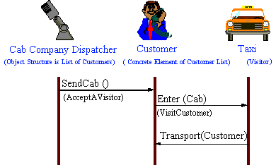

Slide 83
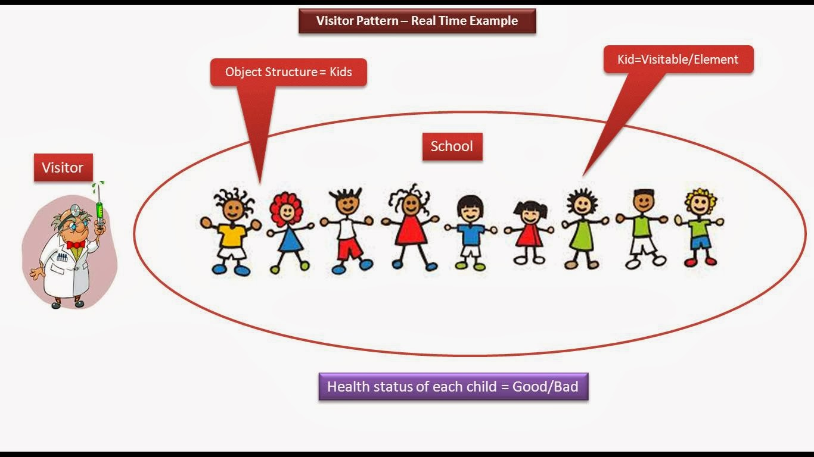

Slide 84
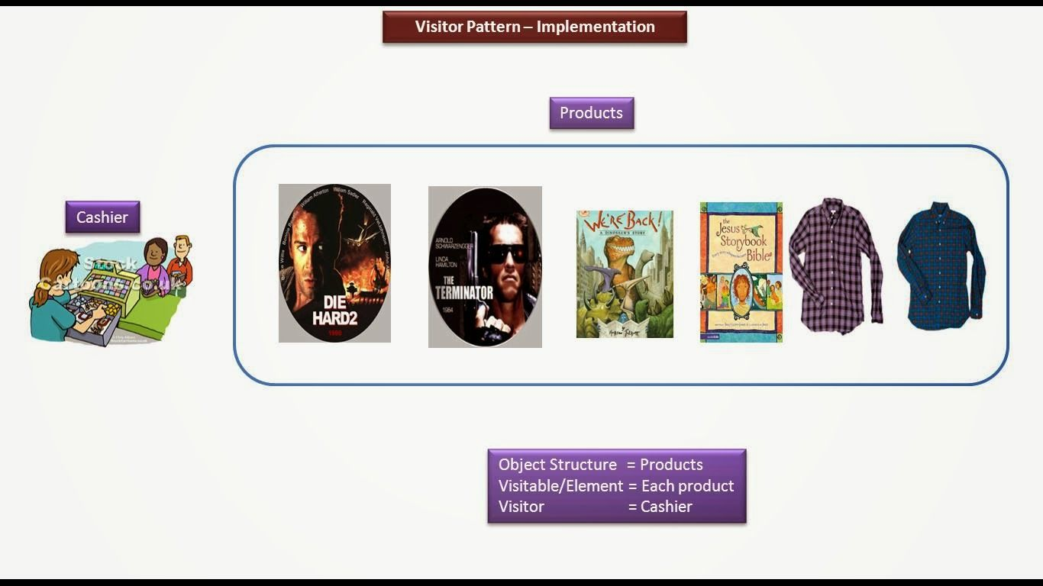

Slide 85
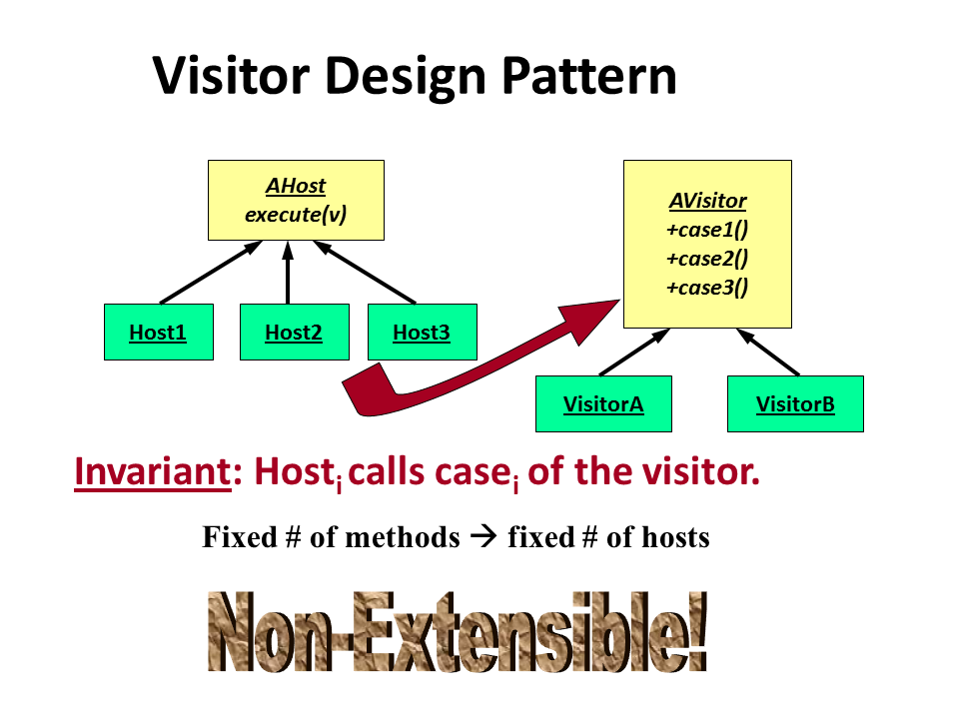

Slide 86
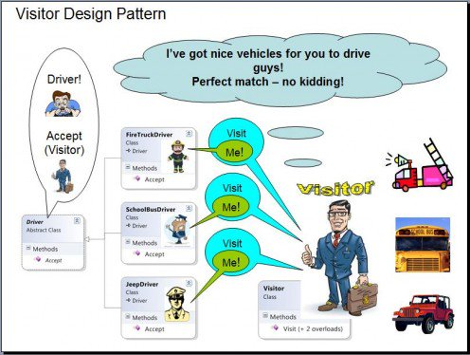

Slide 87
7. Command
Enables the request to be Encapsulated as an object.
A complete command is stored as an object.
Ex. At restaurant – waiter notes down the order in his order sheet
Ex. Remote control buttons

Slide 88
What does the famous saying
“your wish is my command“ mean?
It means, whatever you wish for,
I will do it as if it is a command.

Slide 89
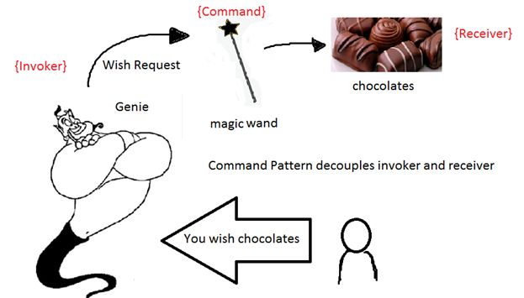

Slide 90
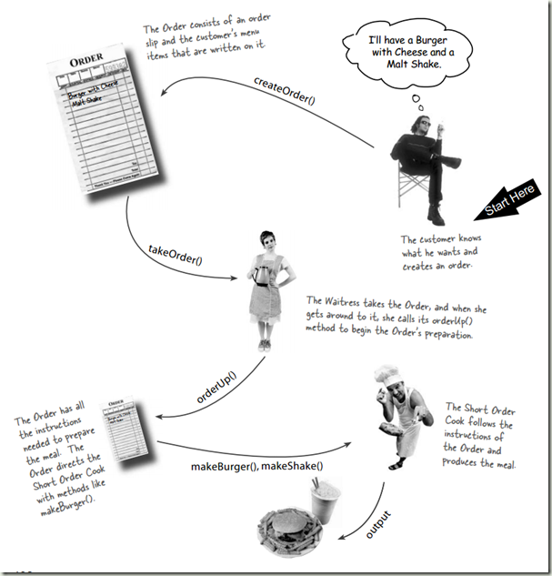

Slide 91
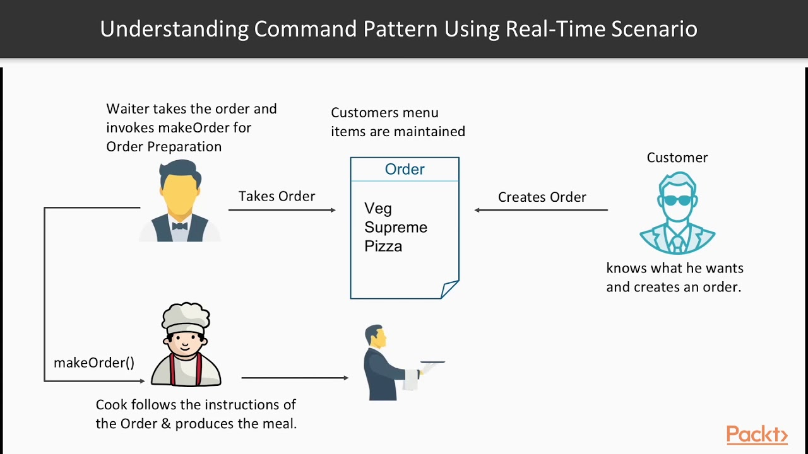

Slide 92
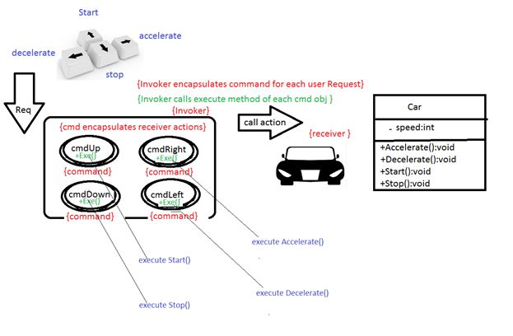

Slide 93
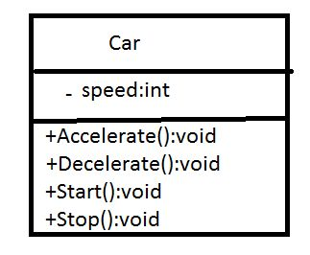
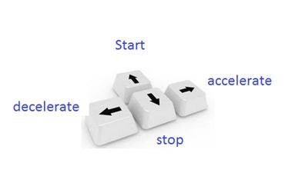
You are making a game application and you need to control a car instance with arrow keys. The car movements or actions must be controlled by arrow keys.

Slide 94
8. Memento
Capturing and restoring an object’s internal state.
Stores the state of objects at different points.
Ex. Undo/redo operations in MS Word.
- When something is typed in MS word,
- it stored in an object.
- When we do undo/redo,
- The object will be completely restored there.
Ex. Saving the intermediate states of the game.
Ex. checkpoints, save points in a transaction.

Slide 95
9. Mediator
Defines Simplified communication between classes.
Encapsulates coordination logic
- in an object,
- that defines
- how a group of objects interact with each other.
Ex. Air traffic controller.

Slide 96
10. Template Method
Template or skeleton of an algorithm is defined in a class
Then subclasses are allowed to vary few steps
without changing the original structure.
Defer the exact state of an algorithm to a subclass.
You can create a class with predefined steps.
Ex. House plan.

